Slide 1
Where is the value in quantum (PhDs)
Quantum and Nano Undergraduate Day
26th November 2025
Benjamin Stratton,
4th Year PhD Student, Quantum Information Theory Group, The University of Bristol

Slide 2
Overview
What properties of quantum objects are “valuable”.
The framework of quantum resource theories.
What value my PhD has given me.

Slide 3

“Quantum computers can solve problems intractable on classical computers”
“Quantum sensors can offer a higher level of precision over the best classical sensors”
“Quantum states can exhibit non-local correlations, classical states cannot”
Quantum Enthusiast
“Quantum cryptography protocols offer a higher level of security then classical cryptography”
“Quantum States can be teleported over channels in which quantum information cannot be sent”

Slide 4
Quantum objects have value
Task with quantum object
Task without quantum object
>

Slide 5
What property gives quantum objects their value?
What is the property that without, quantum tasks can perform no better then classical tasks.

Slide 6
What property gives quantum objects their value?
Unital
Rank
Purity
Unitary
Dynamics
States
Entanglement
Purity Preserving
Non-local Correlations
Low Entropy
Entanglement Generating
Incompatible
Projective
Measurements
Degenerate

Slide 7
What property gives quantum objects their value?
As far as we know, no one property provides the value in all quantum information processing task.
Specific tasks require quantum objects with specific properties.

Slide 8
Focus the question:
Given a property of a quantum object, when is it “valuable”?
We want to rigorously defined the notion of “value”.
For what tasks is the property useful?
Would like to be able to quantify how much of this value property we have.
Answering such question is the goal of
quantum resource theories.

Slide 9
Basic premise behind a resource theory
Place an agent under a set of physical constraints
These constraints limit the agent’s ability to generate objects with the property of interest.
I say a property that cannot be generate is a resource.
Now ask: what can our agent not achieve under these constraints (i.e., without access to objects possessing this property)
If a given task cannot be achieved without objects possessing this property, that property is resource for that task (under this set of constraints).
Free objects – these are the objects the agent can reach under the allowed operations

Slide 10



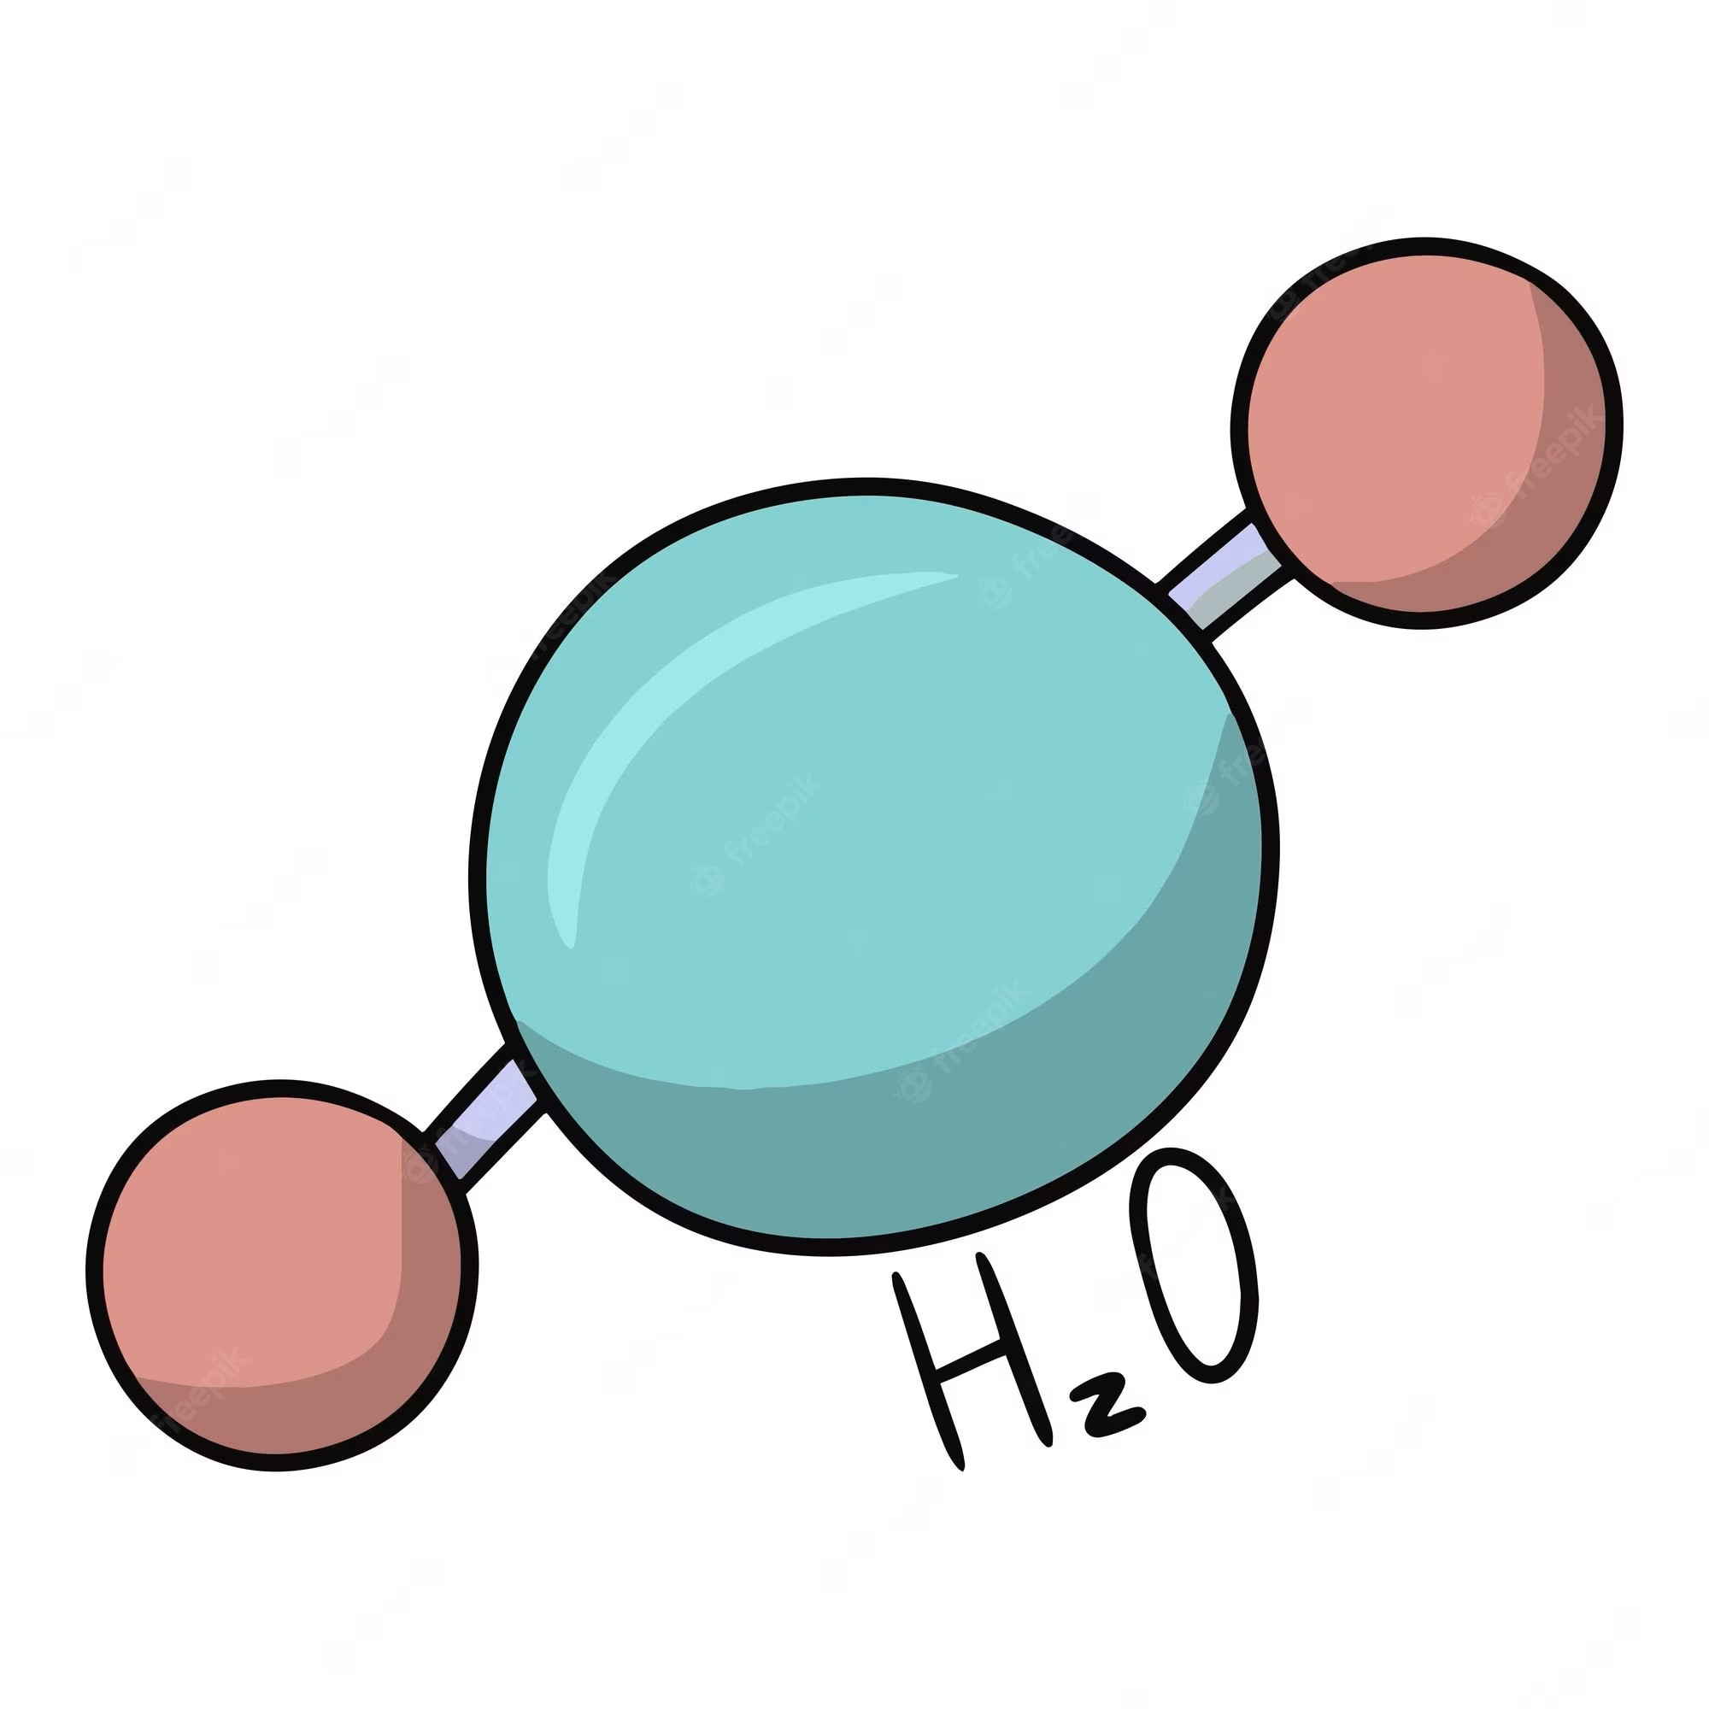

Value (resourcefulness) arises from limitation
Our Agent
Time
Nothing is a resource for an all powerful agent
Notes:
Initially define a resource as something useful or valuable
An all powerful agent can have any amount of anything of do anything

Slide 11
Value (resourcefulness) arises from limitation
Physical Constraints: The Laws of Physics
Therefore have limited access to:
Finite speed of light
Time
Energy Conservation
Quantum Mechanics
We now have a more concrete notion of value (via limitation)
And they are consumed to perform a useful task
Notes:
When considering these constraints things become limited
It is limited access to them that gives them value
If you could have an infinte amount of something, it has not value.

Slide 12
Set of all operations
Physically Constrained Universe
Allowed operations – operations the agent can performed in their constrained universe
Notes:
Restrict what it is the agent can do to isolate your property of interest

Slide 13
Set of all objects
Physically Constrained Universe
Free objects – objects upon which the allowed operations act invariantly

Slide 14
Physically Constrained Universe
Set of all objects
Agent can generate any object in the free set under the allowed operations.
Given a free object, the agent cannot leave the set of free objects under allowed operations
Free objects
Free Object
Free objects – these are the objects the agent can reach under the allowed operations

Slide 15
Physically Constrained Universe
Set of all objects
Agent cannot generate this object under allowed operations.
Free objects
Resourceful Object
Free objects – these are the objects the agent can reach under the allowed operations

Slide 16

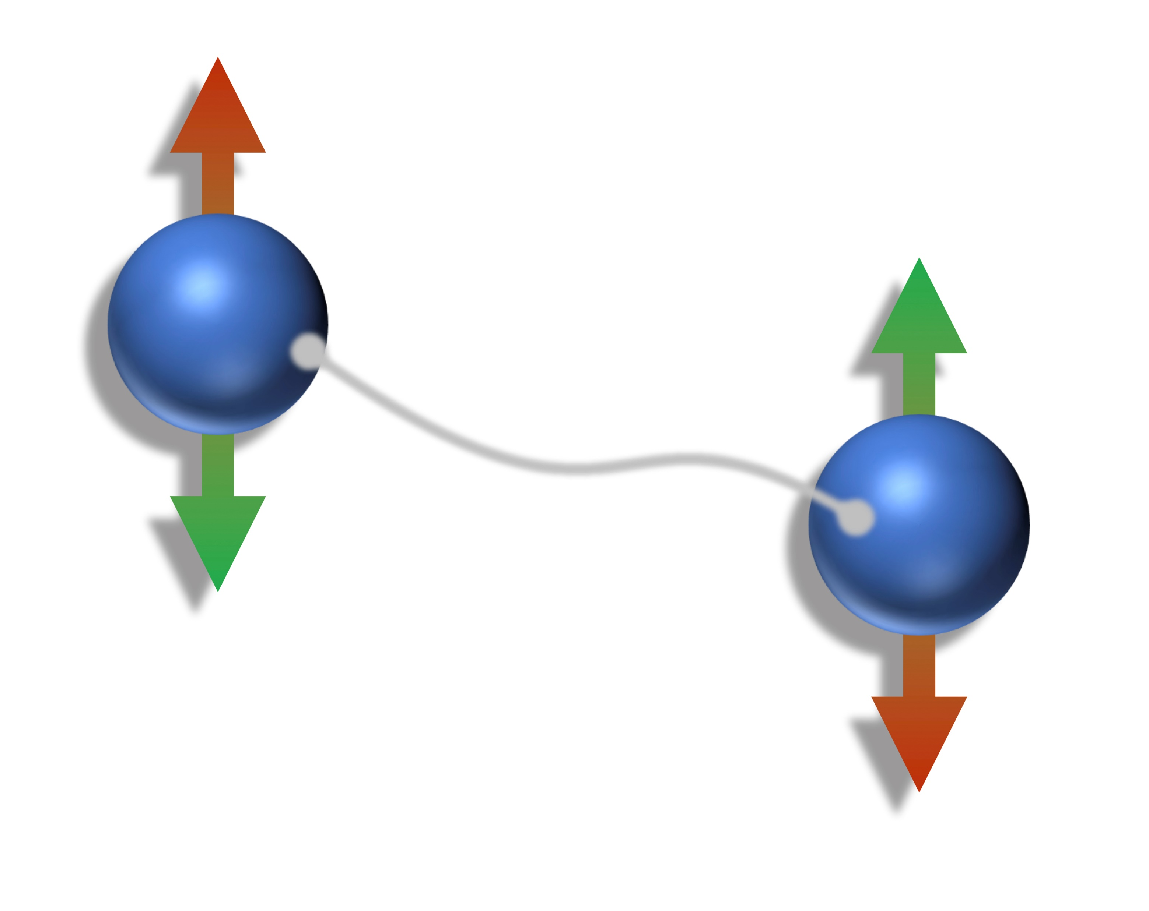
Example: Entanglement
Allowed Operations :
Local Operations
, Classical Communication (LOCC)
Given a separable state, LOCC cannot generate any entanglement.
Alice
Bob
Physical Constraints Allowed operations: LOCC Free Objects: Set of Separable States
Notes:
Cannot generate any entanglement through LOCC
LOCC is resource non-generating
Teleportation is the simulation of a noiseless quantum channel sending one qubit from Alice to bob

Slide 17
What task is entanglement a resource for?
Under allowed operations (LOCC):
Cannot perform quantum teleportation
Can perform quantum teleportation
Set of all quantum states
Entangled state
Separable
States

Slide 18
Entanglement is a resource for the task of quantum teleportation
Note, this is true under this set of physical constraints (LOCC).
Under a different set of physical constraints, entanglement might not be considered a resource.

Slide 19
In the resource theories framework, what is a valuable (resourceful) is dependent on the physical constraints of the system.
Start:
Set the physical constraints
Choose a property
What properties are valuable
Physical constraints

Slide 20
In Summary:
Quantum resource theories are a mathematical framework for quantifying what properties of quantum objects are valuable for performing certain quantum information processing tasks within a set of physical constraints.

Slide 21
What about the personal value in a quantum PhDs?
A short summary of what I’ve got out of my PhD

Slide 22
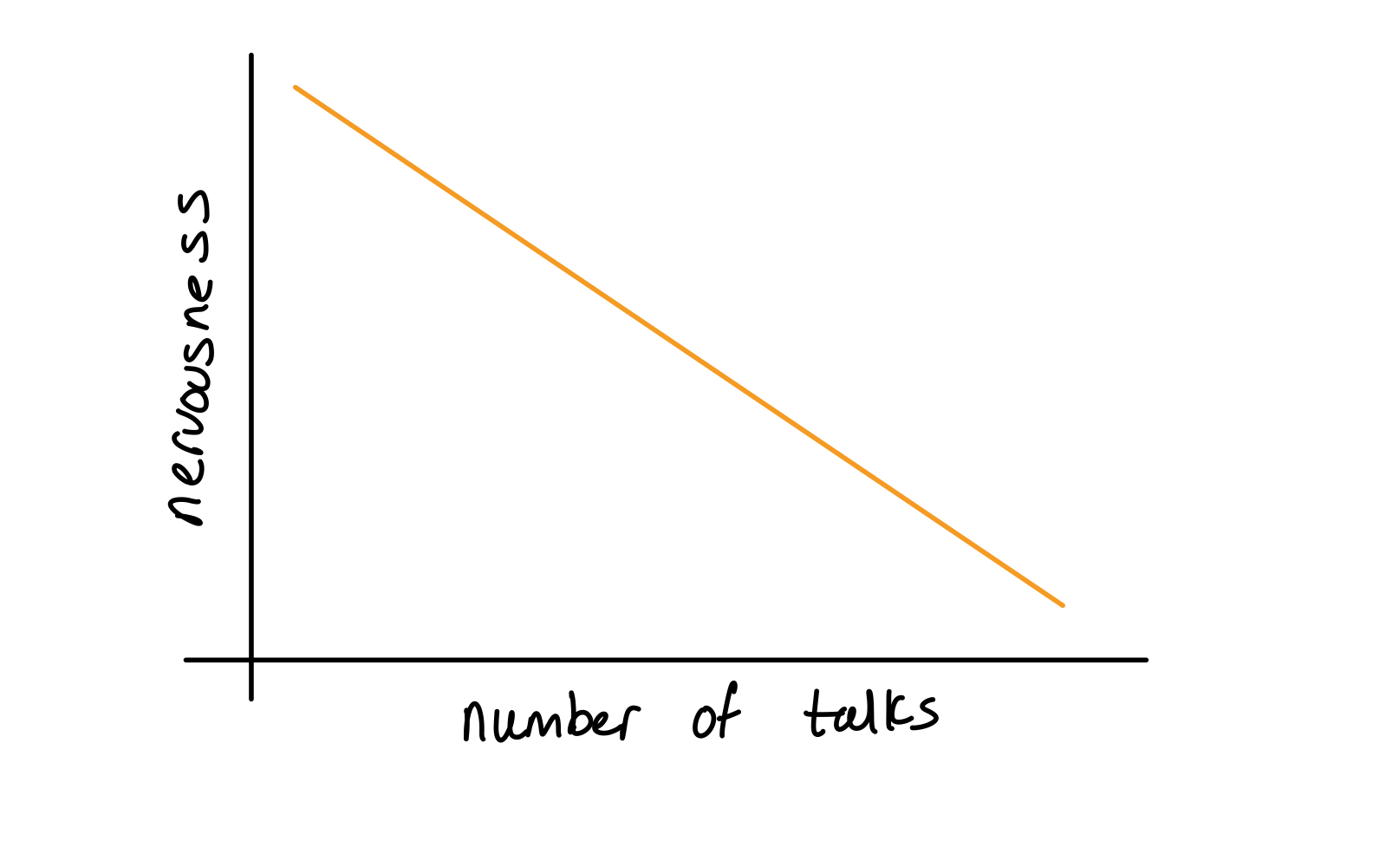


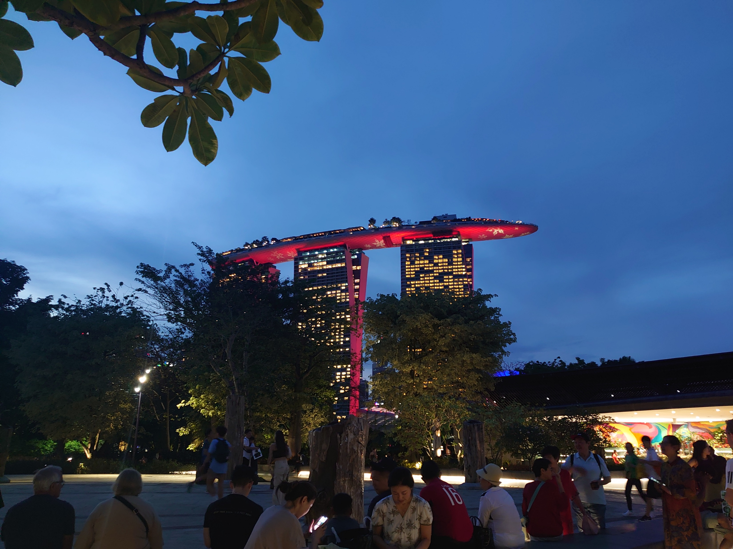

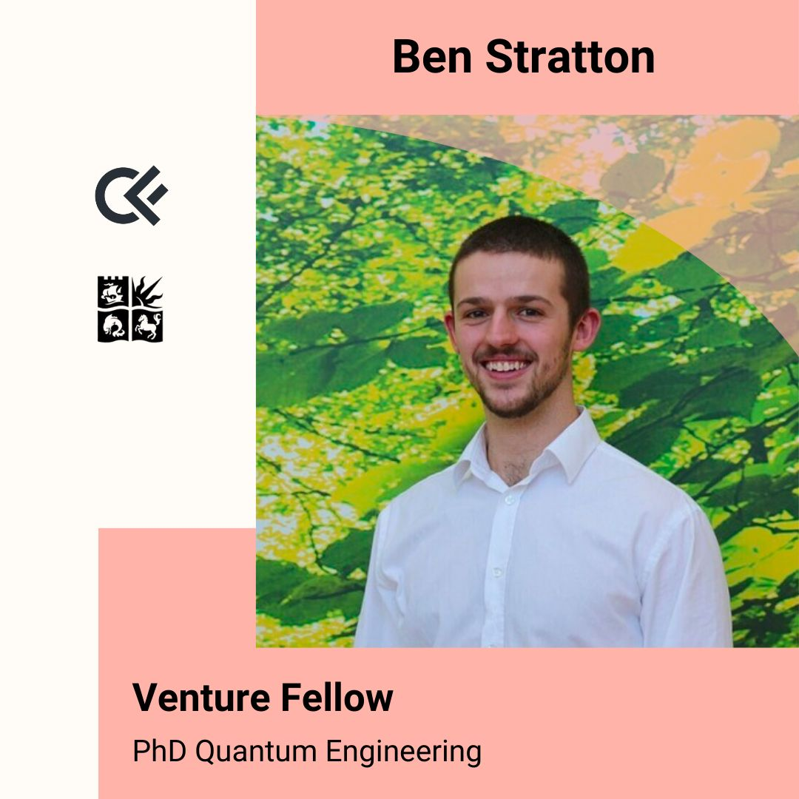
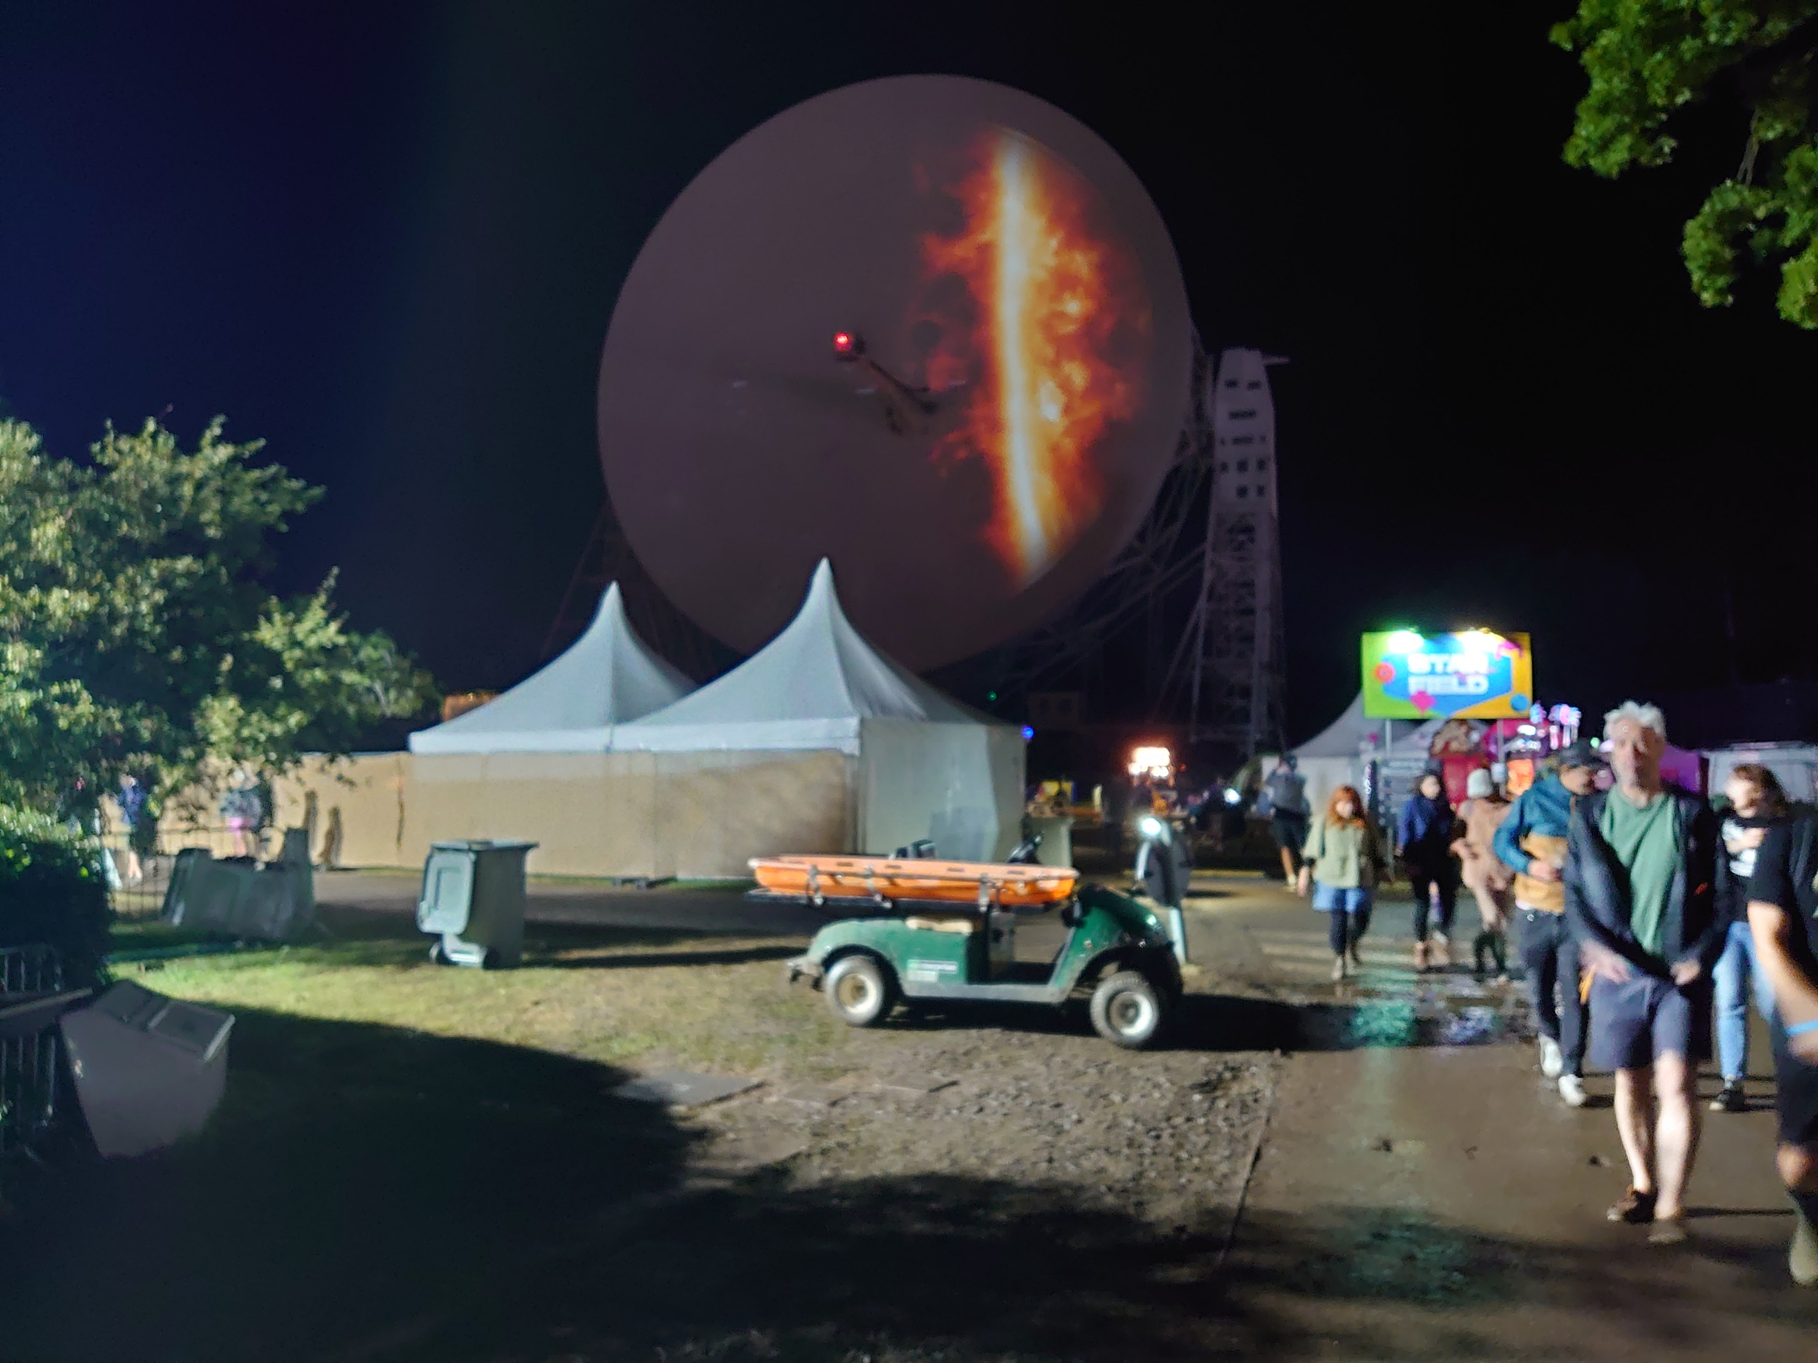

Travelled the world
California, Singapore, Canda, Australia and more!
Outreach with members of the public
Blue Dot, Swinden Science Festival
Worked with a deep tech VC
Soft Skills
Communicating complicated information simply.
Public speaking.
Event Organisation.

Slide 23
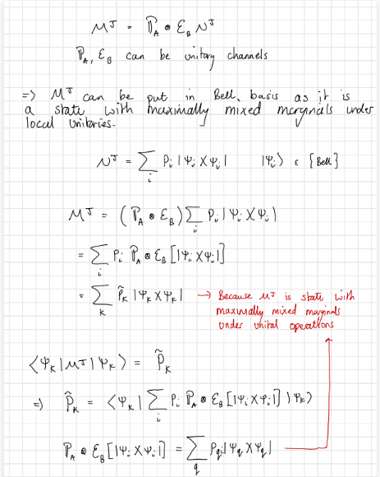
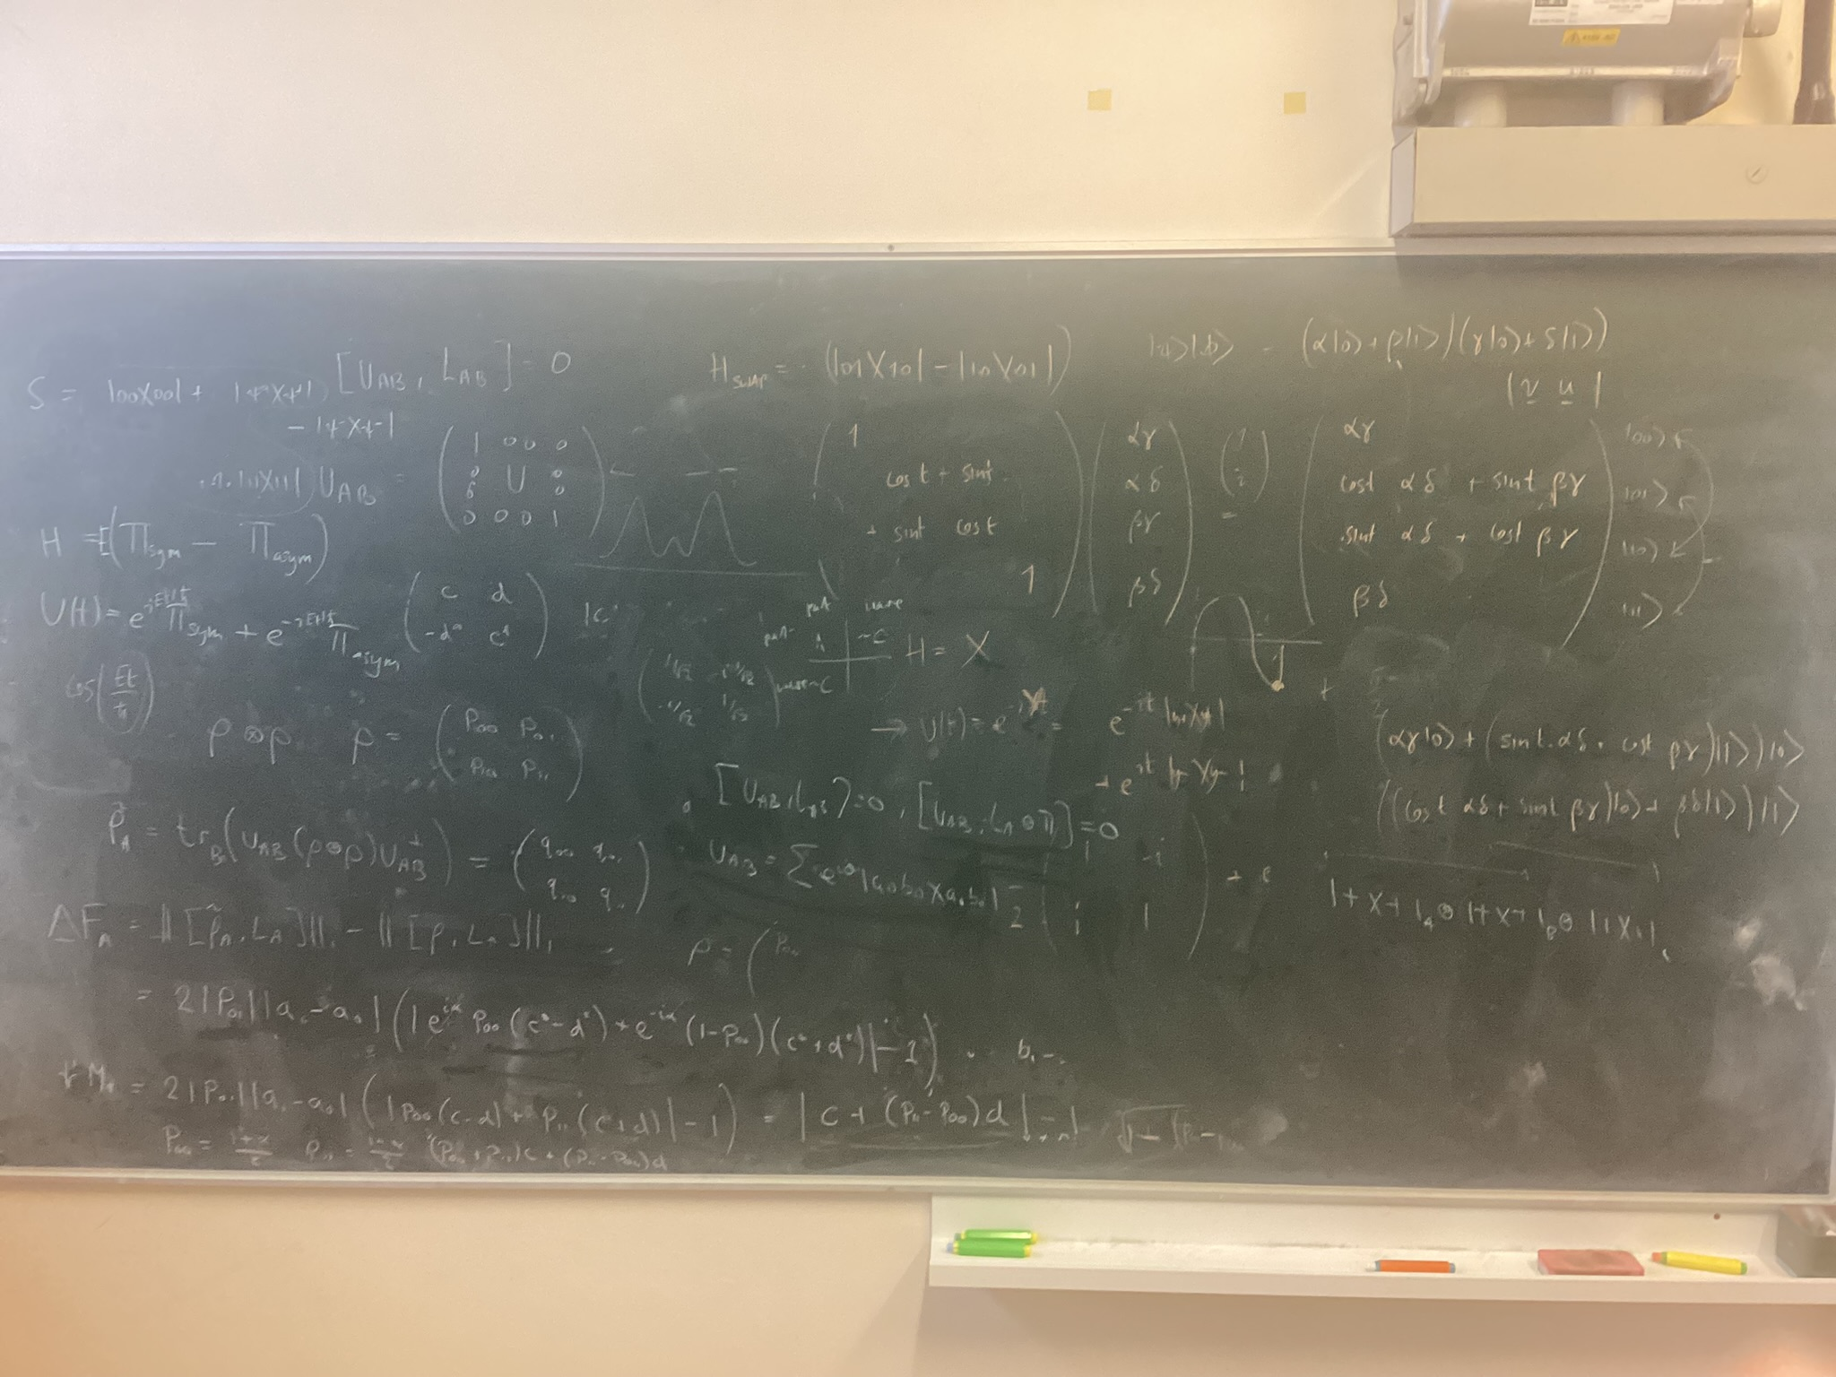
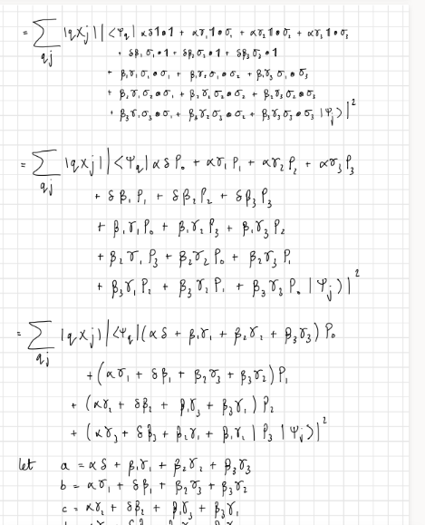
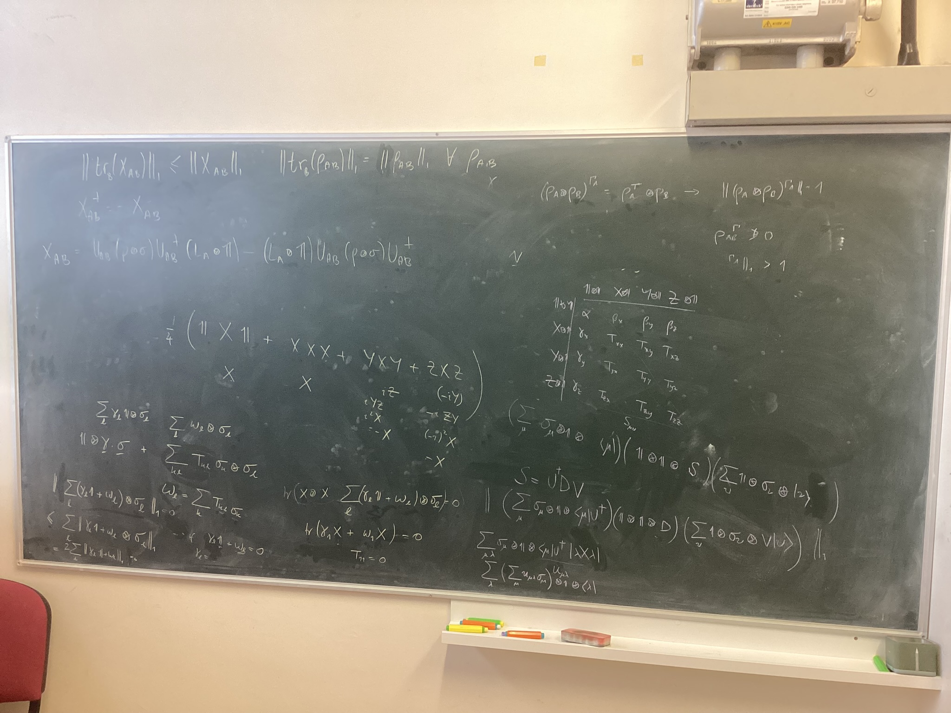
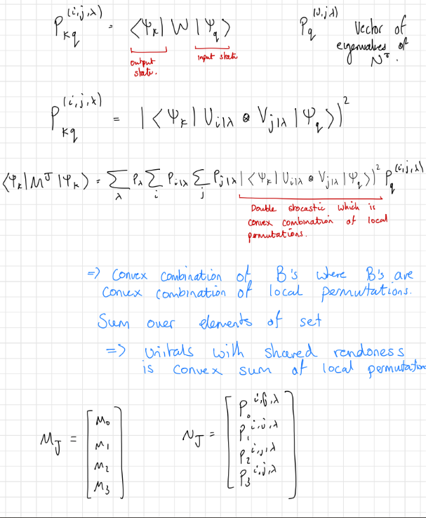
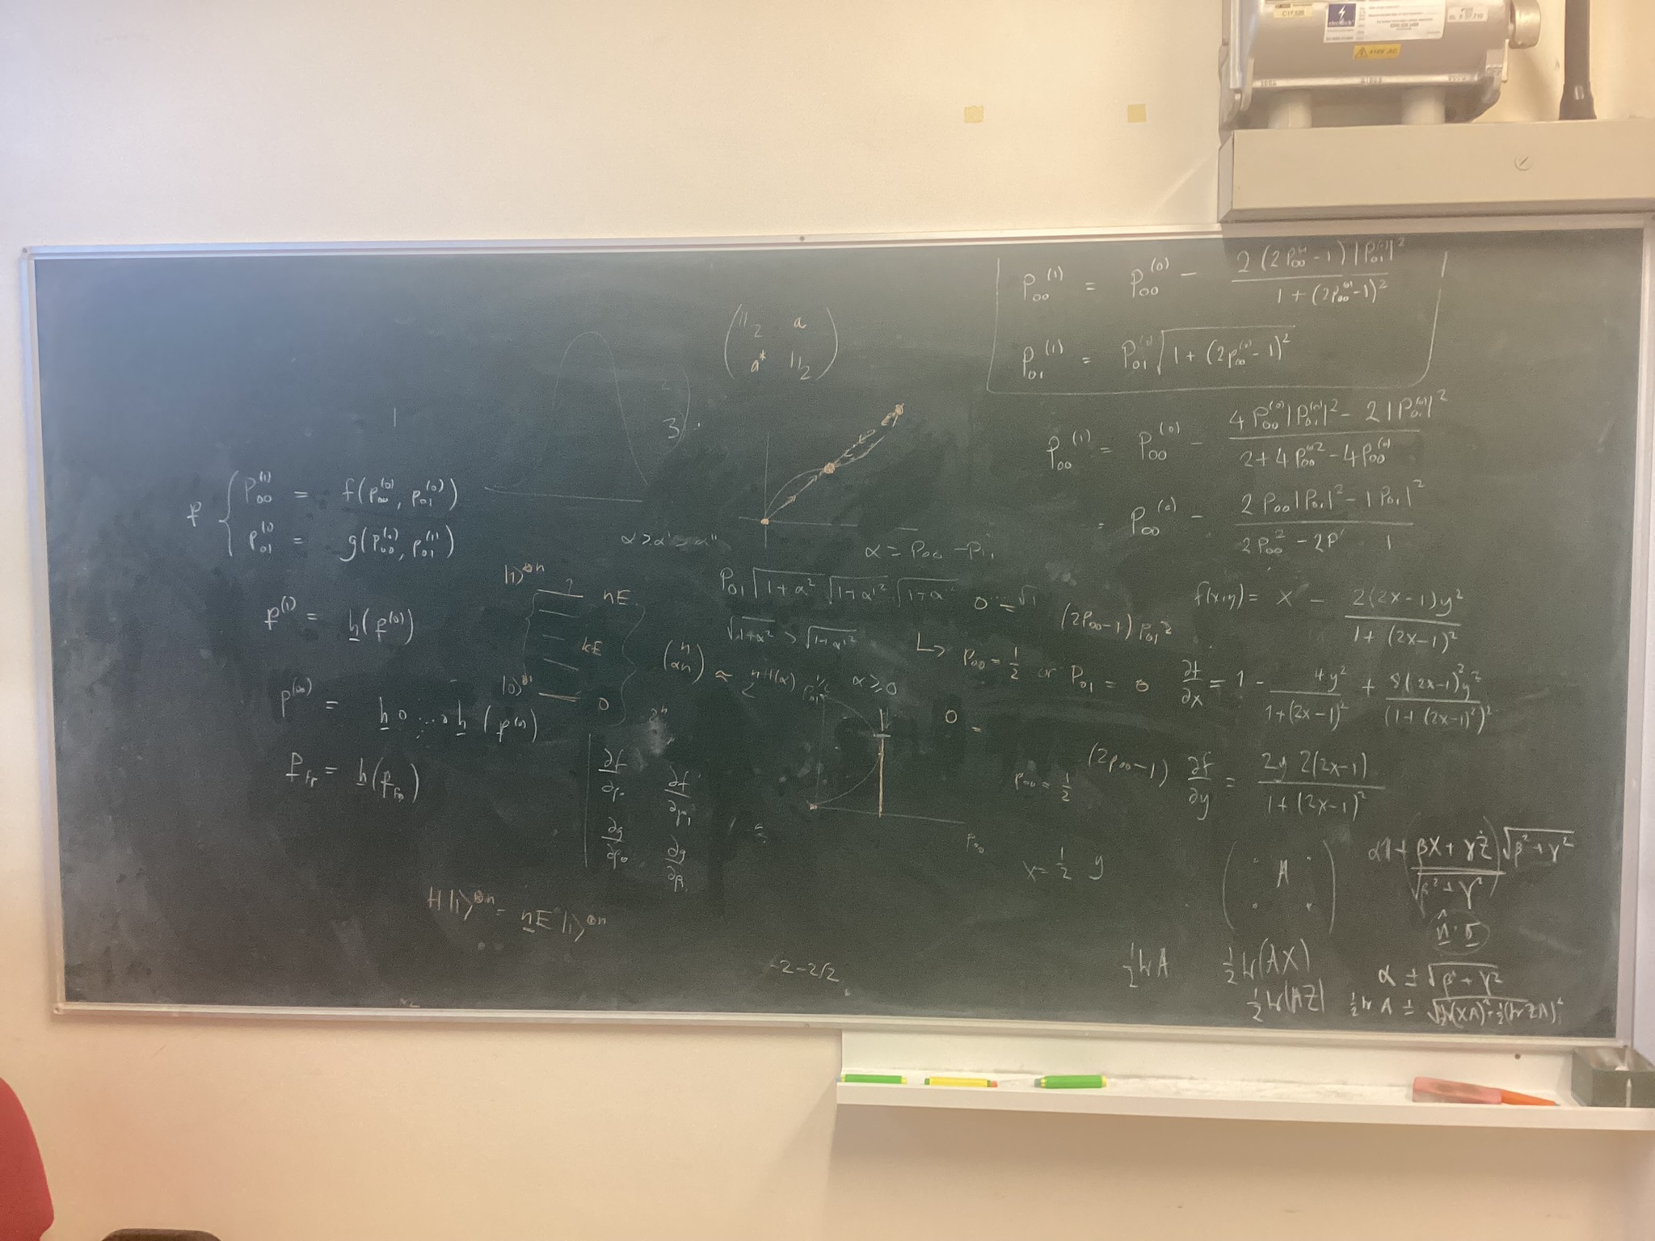
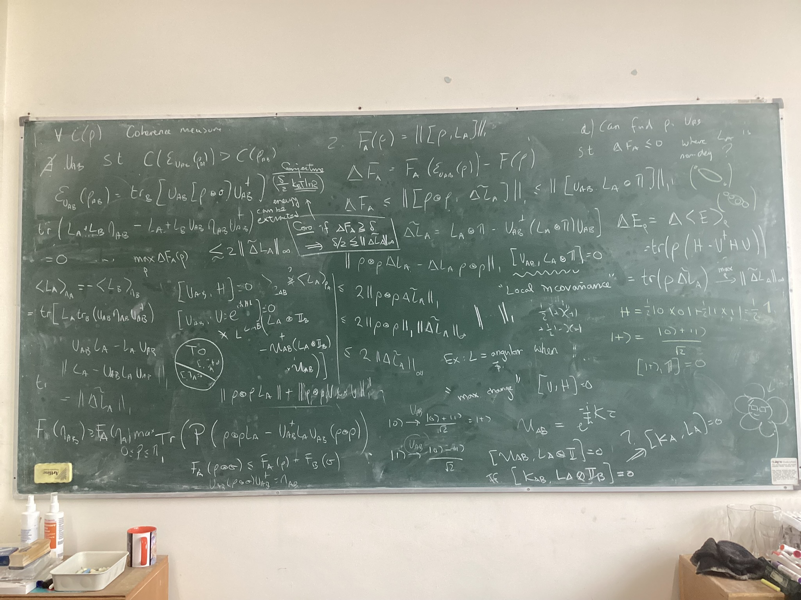
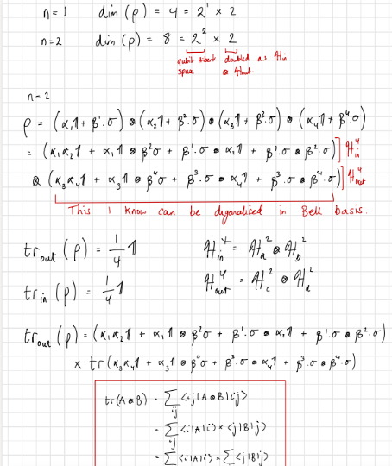
Typical Research Journey
Read a paper, find it interesting
Until…
Either realise it will not work or lose interest
Think of new idea/extension
Discuss with supervisors at the chalk board
Go read, think and do some math's
Discuss with supervisors at the chalk board
Go read, think and do some math's
Discuss with supervisors at the chalk board
Go read, think and do some math's
And so on….

Slide 24
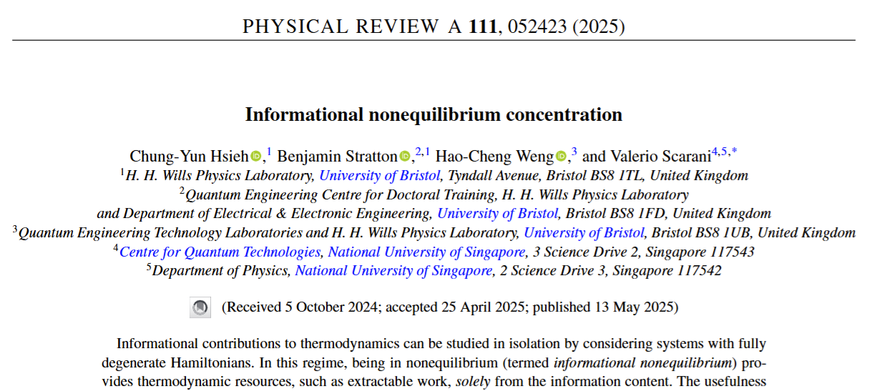
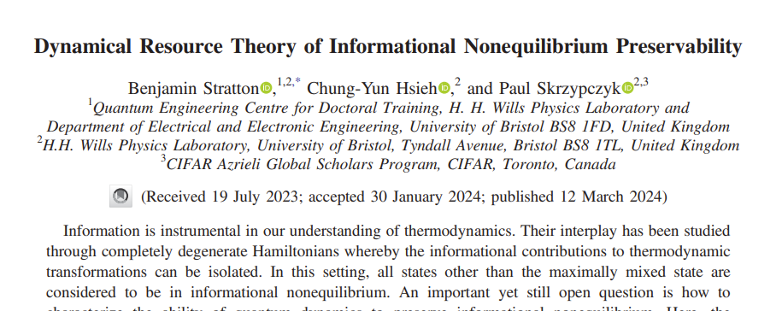
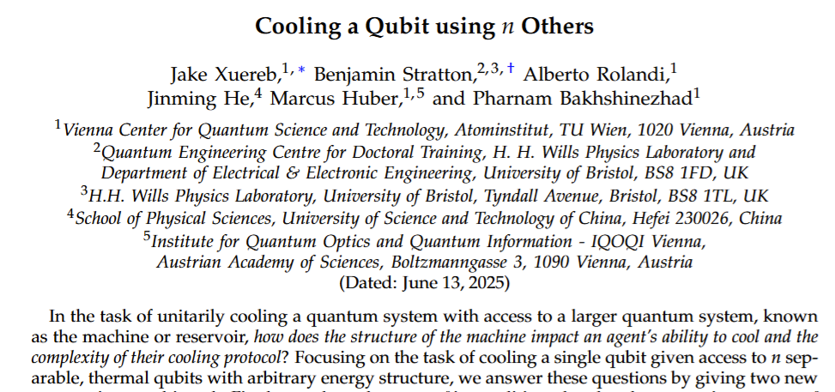
Typical Research Journey
Or write a paper:
Have lots of projects going on at once
Keeps it interesting
Have projects going with multiple different groups around the world
Have collaborations with groups in Vienna and Singapore.

Slide 25

4 Year PhD – 1 year taught and 3 years research
Two mini-projects in year 1.
Open days:
Bristol 12th December 2025, Sussex 16th January 2026
Enhanced stipend as part of “TechExpert” funding for 2026 Cohort only
https://www.qist-cdt.info/
For more Information about deadlines

Slide 26
Where is the value in quantum (PhDs)
Thanks for listening!
For more information on the QIST CDT:
https://www.qist-cdt.info/

Slide 27
Physically Constrained Universe
Set of all objects
How resourceful this object is
Resource can be quantified by there “distance” to the free objects
Free objects
Resourceful Object
Free objects – these are the objects the agent can reach under the allowed operations

Slide 28
Physically Constrained Universe
Set of all objects
A
Free objects
Object A > Object B
B
Free objects – these are the objects the agent can reach under the allowed operations

Slide 29



Resource Theories Structure
Allowed operations:
Resource non-increasing maps of objects to objects
Free Objects:
Objects that contain no resource.
Entanglement Example:
Can use this framework to compare the resource content of objects
= LOCC
= Separable States

Slide 30


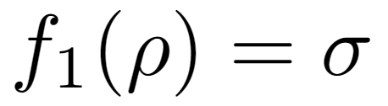



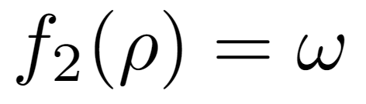
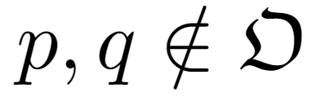
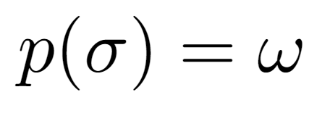
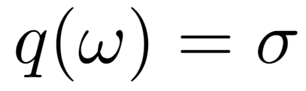

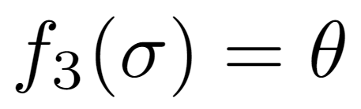
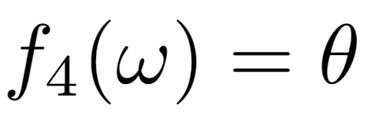
Ordering of Objects
What can we conclude?
Decreasing Resource
Decreasing Resource
What can we not conclude?

Slide 31

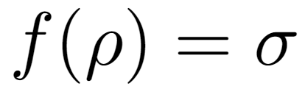
Resource Theory Characterisation
Given two objects and , does there exist an such that
A comparison of the objects resource content can then be made
Overall: A resource theory is the study of limitations imposed by some set of physical constraints
Also consider:
Resource monotones
Simulation of useful channels
Operation interpretations
Catalysis
Resource distillation

Slide 32
What is a Resource?
A resource is anything that allows our agent to overcome the physical constraints of the system

Slide 33
Allow us to define value
Focus the question:
Under a given set of physical constraints, what properties of quantum objects become valuable?
Useful property Resource
Answering these question is the goal of quantum resource theories.

